Slide 1
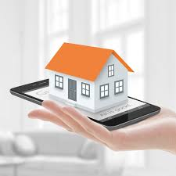
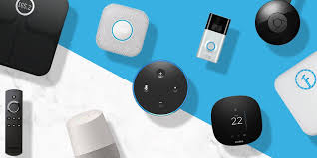
Smart Home Security
By Aaron.M

Slide 2
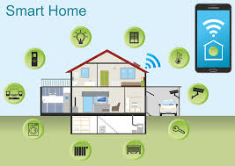
What's Smart Home Security
A Real Smart Home thinks as you do, it will anticipate your needs, doing what is needed when it’s needed. Depending on your presence, the weather, and time of day, it will do all the tasks you usually would, so you don’t have to. Giving you peace of mind to enjoy your day. There’s no need to worry about the thousands of small things necessary to run your home manually. Your Loxone Smart System will do it for you.

Slide 3
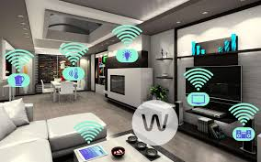
Objectives -
Benefits of smart home security and how they help us during extreme situations as well help protect homes.
Challenges that impact smart home security when an intruder is in your garden.
Automatically adjust lighting, turning off all the lights during the day and on during the night.
CCTV system recording 24 hours and can be viewed through you mobile phone at any time.
Actions to take while an intruder is detected by a CCTV feed and to move to a safe room in the house and alert the police.

Slide 4
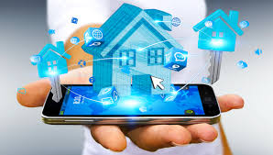
Features of having a Smart Home Security
Smart home Security uses a very effective internet connection
Technology come together with technologies to make your home a better place to live in.
It also looks after the home using CCTVs and report anything suspicious in your area.

Slide 5
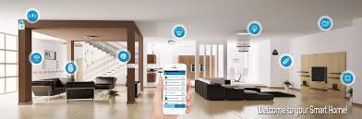
Benefits of Smart Home Security
A smart home security offers a lot more by turning lights off, if no-one is at home and turning on, if there is someone at home this can be efficient and also save electricity.
If there is any emergency then there are fire detectors and heating pipes which are are all connected to the smart home security, this will also notify you on your email as well as send you a text on your phone.
It also lights up a way for you to walk safely to the exit with getting into any trouble.

Slide 6
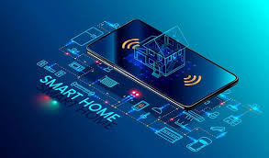
Challenges of Smart Home Security
The challenges are faced when a burglar breaks into your home, the smart home security will make sure it looks like someone is at home so that the burglar would assume someone is at home.
Not only that but there are also CCTVs looking out around the house to make sure that it is perfectly safe and secure. And if someone breaks in the smart home security reveals the burglar’s position through a CCTV camera and can be taken down by calling for help.

Slide 7
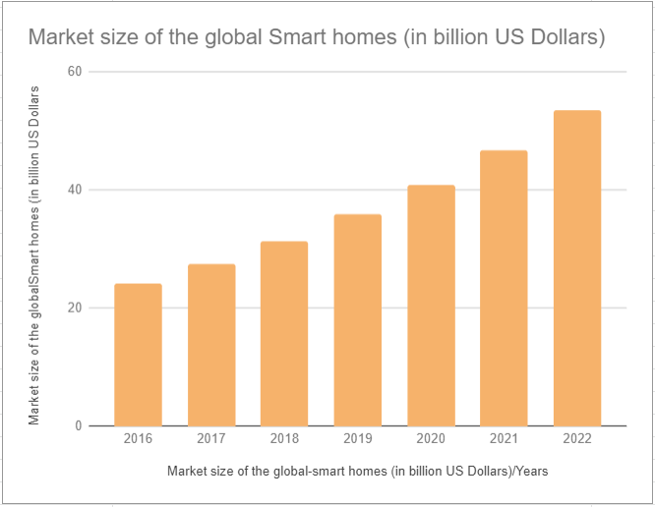
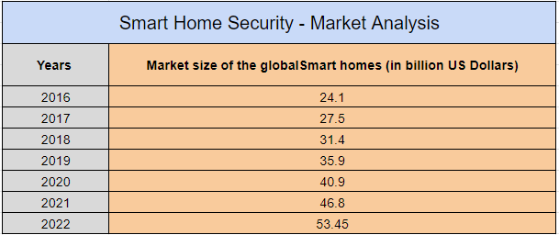
Graphs and Charts - 1
Description -
The statistic shows the market size of the smart home market worldwide from 2016 to 2022.For 2020, the source forecasts the global smart home market to grow to around 40.9 billion U.S. dollars.
https://www.statista.com/statistics/682204/global-smart-home-market-size/

Slide 8
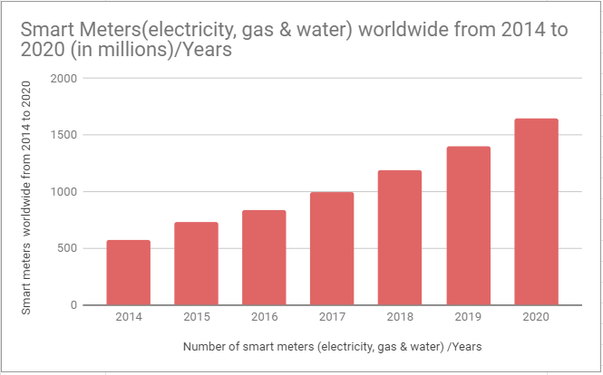
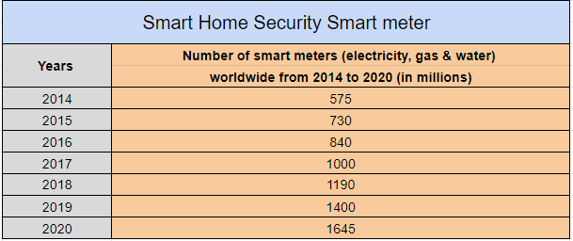
Graphs and Charts - 2
Description -
This graph shows the forecast installed base of smart meters worldwide from 2014 to 2020. In 2017, the installed base of smart electricity, gas and water meters is projected to rise to one billion.
https://www.statista.com/statistics/625890/worldwide-smart-meter-deployment/

Slide 9
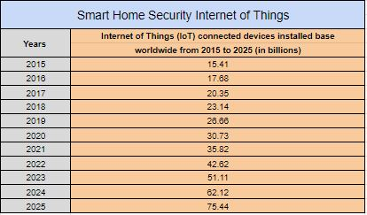
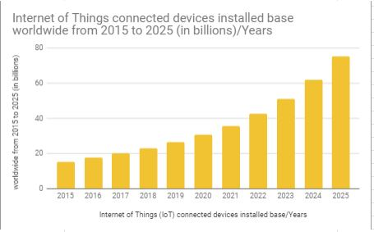
Graphs and Charts - 3
Description -
This statistic shows the number of connected devices (Internet of Things; IoT) worldwide from 2015 to 2025. For 2020, the installed base of Internet of Things devices is forecast to grow to almost 31 billion worldwide. The overall Internet of Things market is projected to be worth more than one billion U.S. dollars annually from 2017 onwards.
https://www.statista.com/statistics/471264/iot-number-of-connected-devices-worldwide/

Slide 10
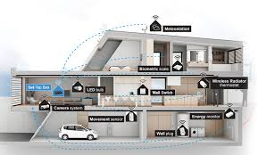
Moral & Critical issues of Smart Home Security
There may be hackers that try to bypass the security to tap into the CCTV cameras, or snoop into the browser history to collect valuable information.
If there is a power outage in the vicinity, the home becomes vulnerable to robbery, safety, health, electrical hazards , etc.
If there is no back-up power supply in case of an outage, this could lead to appliance in the house to be useless and not functional.

Slide 11

Conclusion
Smart home security is essential for the protection from intruders and other disasters. With AI in control it really make for a strong and reliable service which not only helps to protect homes but also providing additional features to keep it secure and protected. But this is not always the case as there may always be some devices with any malfunctions or could also be a threat if someone hacks into it. It is not as reliable as you would expect. Just make sure you know you’re in control of your devices.

